Slide 1
Welcome to Amsterdam
Henry J.C. de Vries
STI outpatient clinic, Municipal Health Service (GGD) Amsterdam
Dermatology, Amsterdam University Medical Centers, University of Amsterdam

Slide 2
Disclosure
Relations that could be relevant for the meeting | Company names
Sponsorship or refund funds
Payment or other financial remuneration | Medigene Gilead MSD Abott Janssen Novartis
Shareholder rights
Other relations

Slide 3
STI care in old Amsterdam: being seen “under the clock”

Slide 4
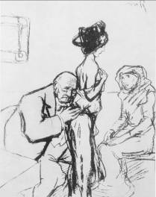
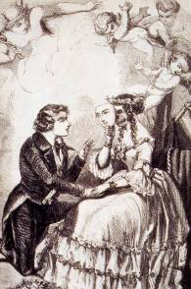
Reglementarism
mid 1800
hygienist (MDs) and the military
male libido as a sign of virility
regulation of brothels
obligatory check ups for sex workers
work ban if necessary

Slide 5
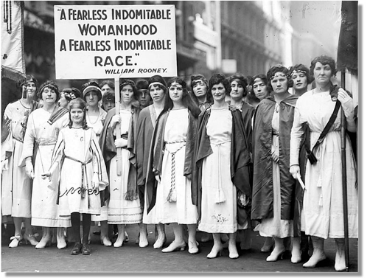
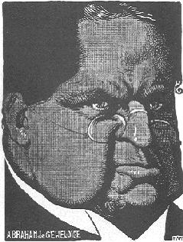
Abolutionism
Since 1880 (Victorian age)
fight against indecency
religious leaders and 1st feminist movement
1911: indecency act
ban on brothels
1914 Dutch Union against STI
anti reglementarist
anti contraceptives

Slide 6
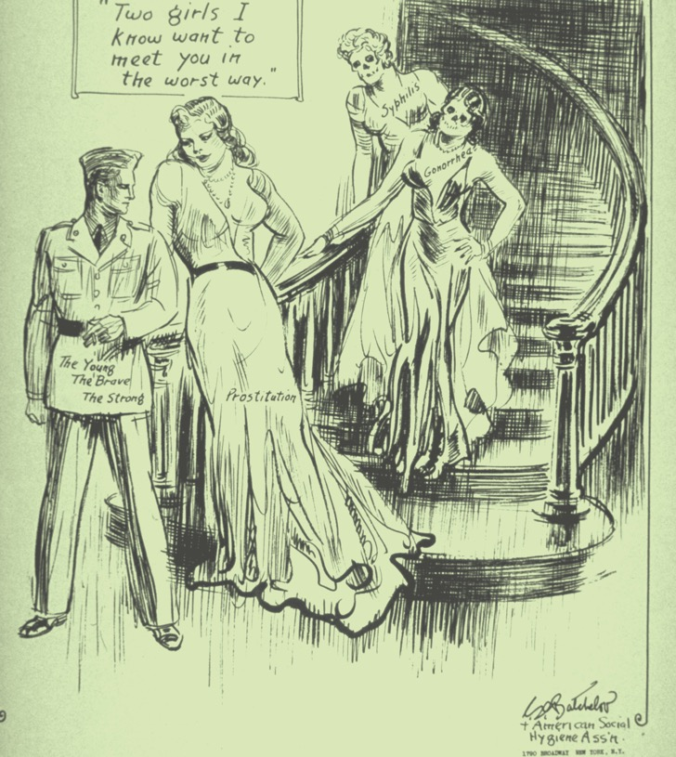
Reglementarist campaigns

Slide 7
Abolutionist campaign

Slide 8
1970s campaigns

Slide 9
1980-1990s campaigns

Slide 10
STI care back then
government is leading
reglementarists
MDs (hygienists)
military
pragmatic
top down
law enforcement
(criminalization)
society is leading
abolutionists
religion and morality
feminists
idealist/activistic
bottom up
own responsibility
sexual health/rights

Slide 11
STI care back then and at present
government is leading
reglementarist
MDs (hygienists)
military
pragmatic
top down
law enforcement
(criminalization)
society is leading
abolutionist
religion and morality
feminists
idealist/activistic
bottom up
own responsibility
sexual health/rights

Slide 12
The Dutch approach
Stimulating research environment & health infrastructure
Internationally acknowledged STI and HIV research institutes covering a wide range of disciplines
Pragmatic and non-normative attitude in sexual and reproductive rights and health
Speedy application of scientific results into the real world with a modest budget
Involvement of key populations
Strengthening of civil society organizations and networks
Notes:
In the spirit of the late Joep Lange, its goal has been the swift translation of problems arising from real live into research questions and the subsequent implementation of results into practice.
Dutch minister Lilianne Ploumen pledged 10 million euro to counter the Mexico City birth control fund policy that was reinstated by Donald Trump in January 2017.

